Slide 1

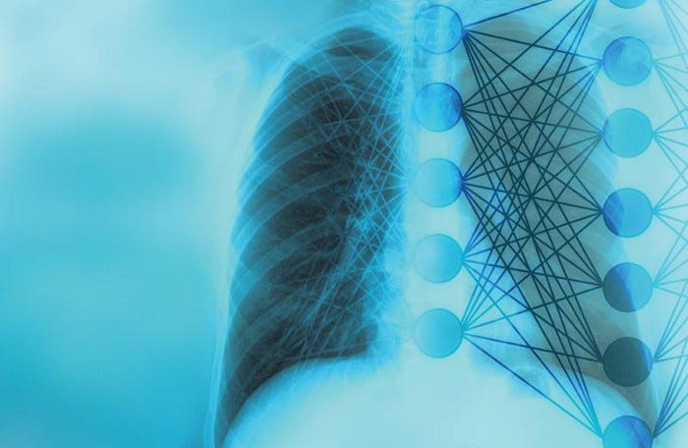
PNEUMONIA DETECTION SYSTEM
M.Kawena 21BAD013
M.Maal Subiksha 21BAD014
G.Monica 21BAD016

Slide 2
ABSTRACT
Pneumonia is a prevalent and potentially life-threatening respiratory infection.
Traditional methods for pneumonia detection are manual and image-based, which are time-consuming and subject to human error.
Deep learning techniques have emerged as promising tools for automating pneumonia detection from medical images.
This project utilizes an ensemble of two pretrained models, VGG16 and Inception V3, to automate pneumonia detection in chest X-rays.
It involves the design, development, and evaluation of the ensemble, including exploring model architectures and data preprocessing techniques.
The project's main objectives are to achieve high accuracy and efficiency in pneumonia detection.

Slide 3
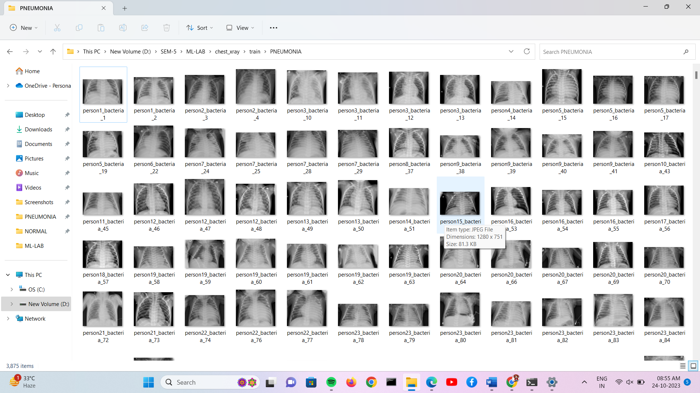
DATASET
The dataset is organized into 3 folders (train, test, val) and contains subfolders for each image category (Pneumonia/Normal). There are 5,863 X-Ray images (JPEG) and 2 categories (Pneumonia/Normal).
Chest X-ray images (anterior-posterior) were selected from retrospective cohorts of pediatric patients of one to five years old from Guangzhou Women and Children’s Medical Center, Guangzhou. All chest X-ray imaging was performed as part of patients’ routine clinical care.

Slide 4
RESULT
• VGG 16
Test loss 0.2547
Test Accuracy 0.9022
• EFFICIENT NET B0
Test loss 0.6918
Test accuracy 0.6250
• ResNet50
Test loss 0.6894
Test accuracy 0.6250
• Inception V3
Test loss 0.4993
Test Accuracy 0.8349
• Ensemble Model
Val loss 0.8119
Val accuracy 0.6875

Slide 5
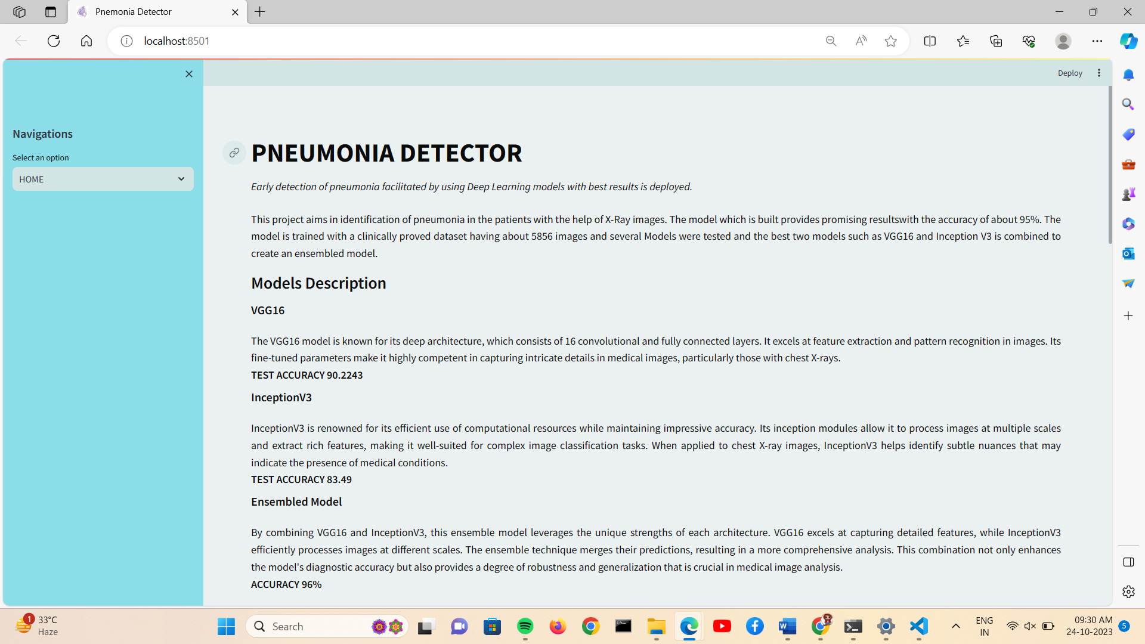
RESULT
GUI

Slide 6
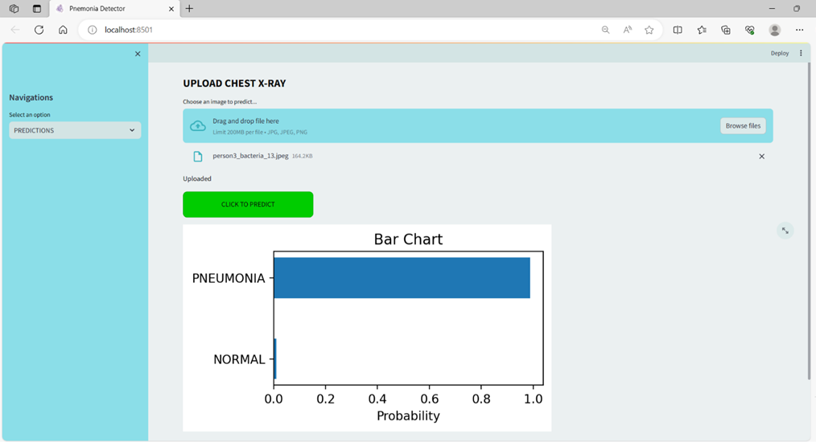
RESULT
GUI

